Slide 1
MIS (Movie Information System)
CSIS3275
Software Engineering
Instructor: Rahim Virani

Slide 2
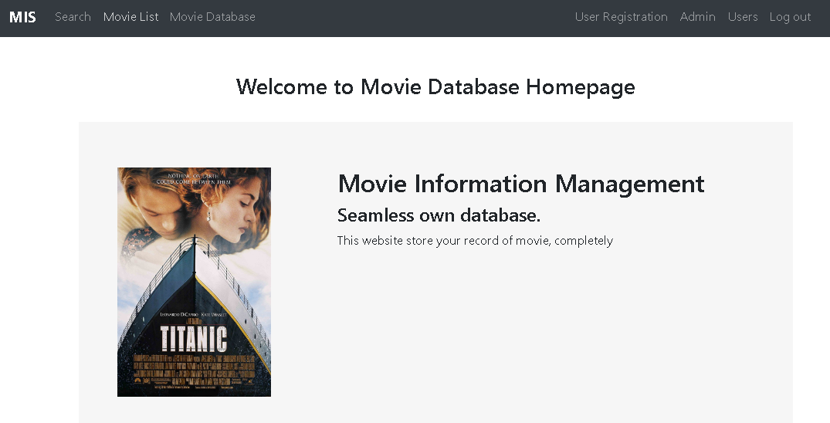
Members
Seongku (Daniel) Ahn as a lead programmer
Administrator (Role management) and user login function
Planning and documentation
Ankit Chutani as a developer
Movie database management function
Testing and documentation
Twinklepreet Kaur as a developer
User management function
Testing and documentation

Slide 3
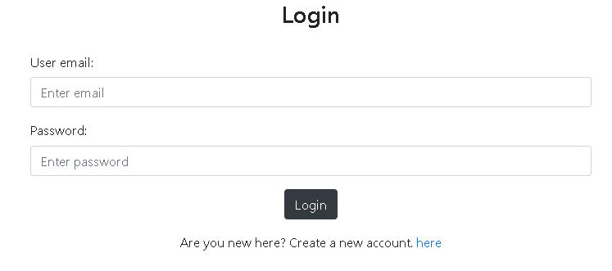
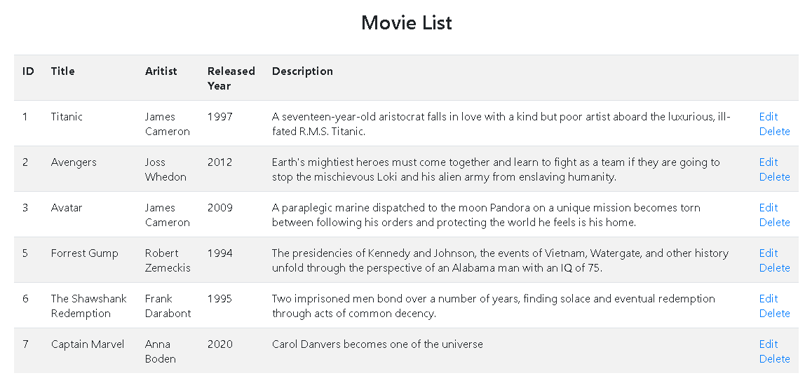
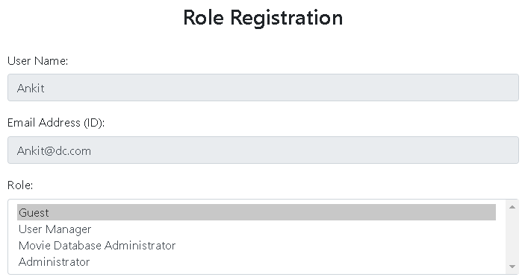
History of Iteration
Iteration 1
Welcome Home Page with Menu, Login, and User Registration with Hibernate
Iteration 2
Movie list, Movie registration, and User list with Hibernate for CRUD
Iteration 3
Movie search and Role management with JUnit

Slide 4
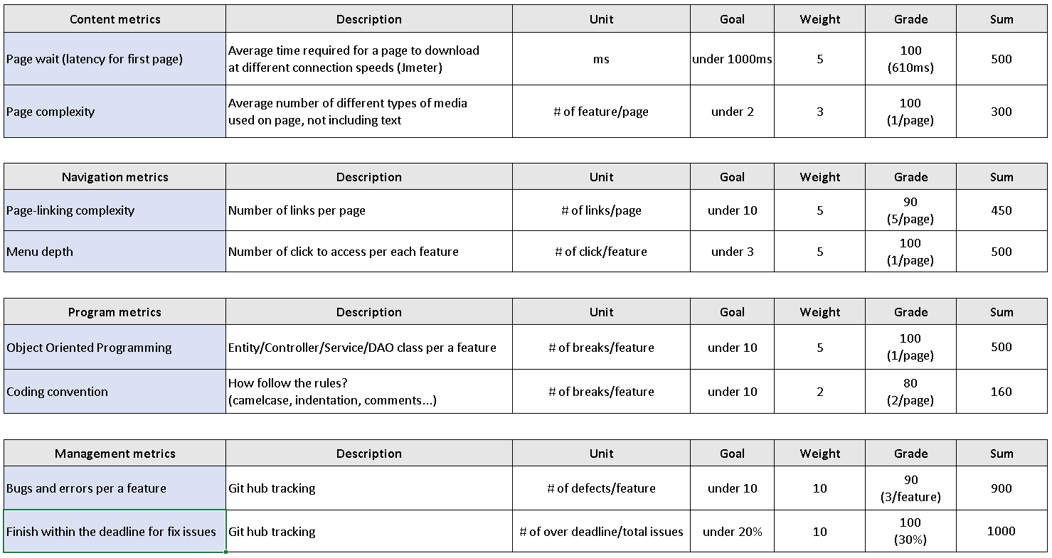
Metrics, Measurement and Goals

Slide 5
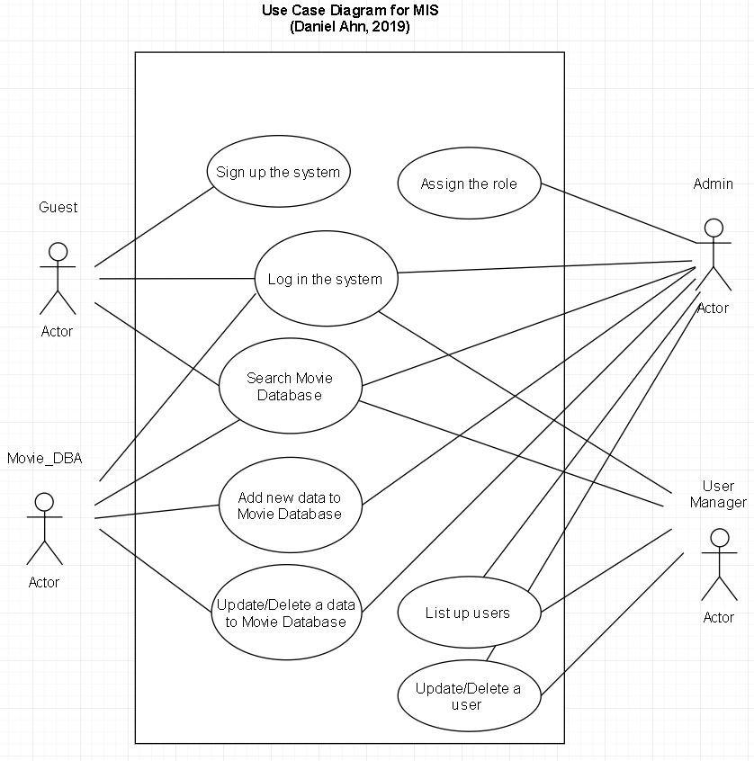
Use Cases and Demonstration
Overall Layout

Slide 6
Project Planning and Issues
Github
Most convenient thing is that we can handle the issue with the simple creation and connect to other menu with minimum clicks.
Easy defect handling: creating, assigning, updating, closing and so on.
Everything merged in this tool without extra load app using user-friendly web-UI.
Similar tools
JIRA (well-known for Agile), Trello (we used this iteration 0), Mantis (old one)
Perforce/Clearcase (code management), Clearquest (defect management)
How to work with Github
Issue handling (over 52 times), Scheduling each iteration, Kanban board with bird-eyes view

Slide 7
Testing & Tooling
Tools
Web interface/GitKraken as Git GUI application
Eclipse STS as IDE
Eclipse with JMeter, JUnit, BlazeMeter (instead of Selenium).
Testing
Blackbox testing with Junit
Whitebox testing with BlazeMeter and by user manually
Performance testing with JMeter and BlazeMeter
Lesson
More focus on user perspective and QA evaluation.

Slide 8
Working in Groups
What we have learned from the project
Management myths: materials and internal seminar can cover everything,
→ because we have different background and culture
Practitioner myths: running the program is not the only target
→ s/w testing, documentation, modeling, and so on during iteration
Appropriate the number of group member
What worked and didn’t
Finished as we planned from the first meeting
More features for movies (extended information)

Slide 9
Lessons Learned
Learned from Agile Modeling Principles
The primary goal of the software team is to build software not create models
→ cut out the initial idea and focus on the main function
Travel light – don’t create more models than you need
→ to meet the deadline and make more realistic way
Strive to produce the simplest model
→ whole UX/UI design and logic

Slide 10
Lessons Learned (Cont’d)
Challenging and competing from Agile Modeling Principles
Adapt the models you create to the system at hand.
→ web based application, but it has been taken some time to adjust it with f/w
Try to build useful models, forget abut building perfect models.
→ limited time and schedule
Get feedback as soon as you can.
→ working together is the most challenging

Slide 11
Thank you

